Slide 1
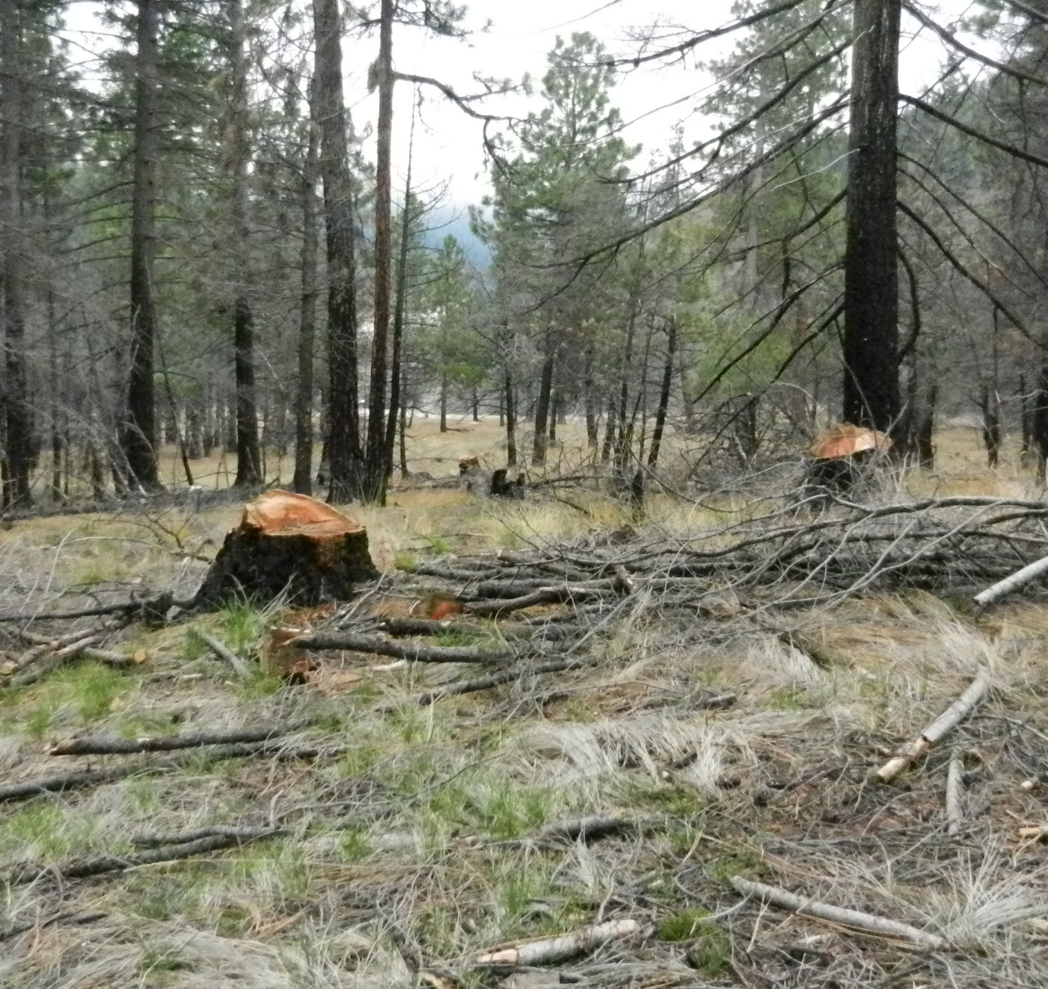
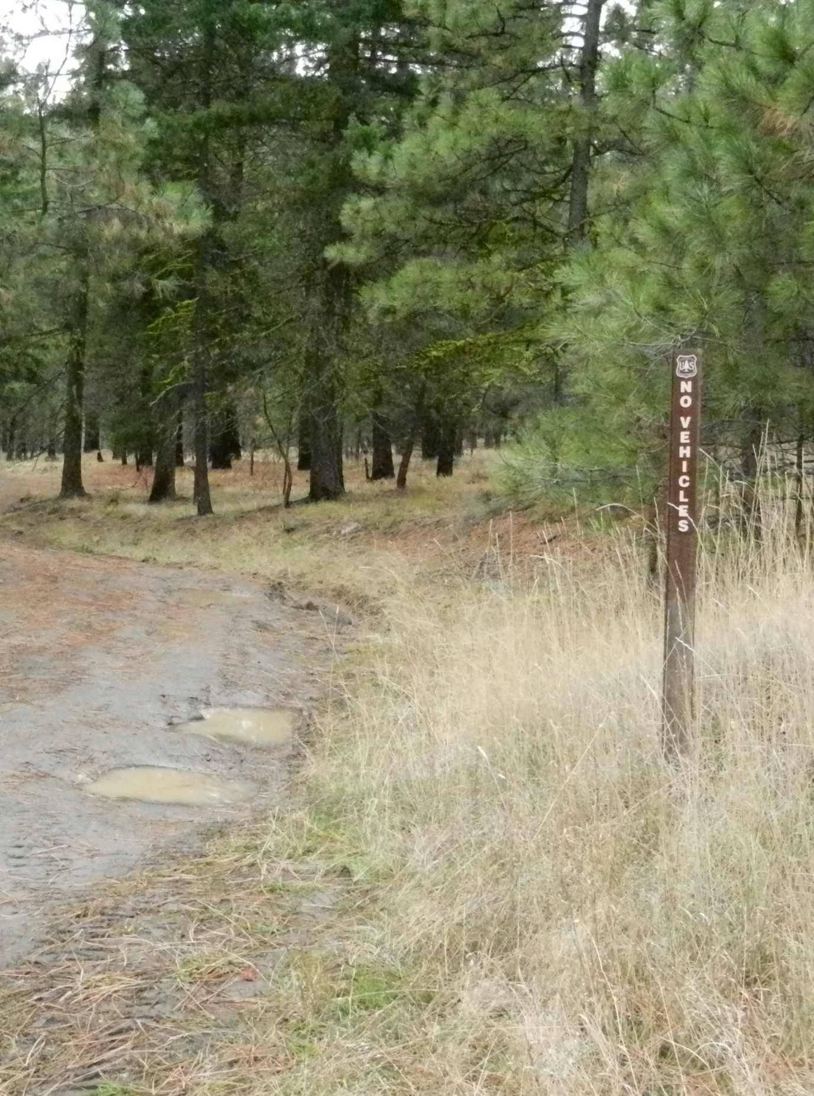
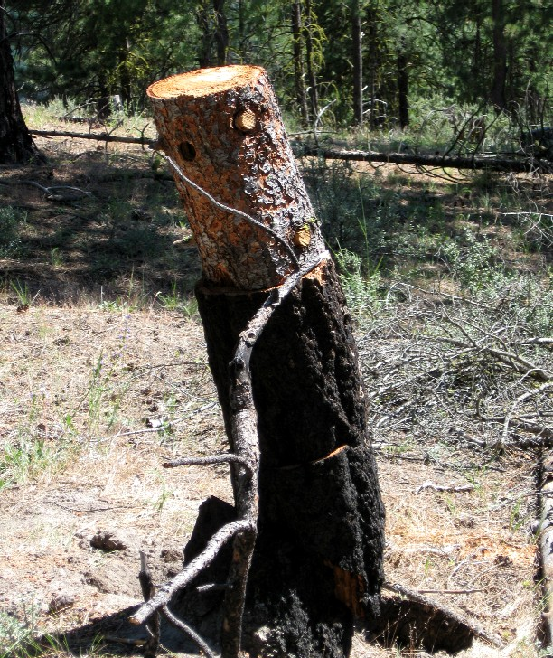
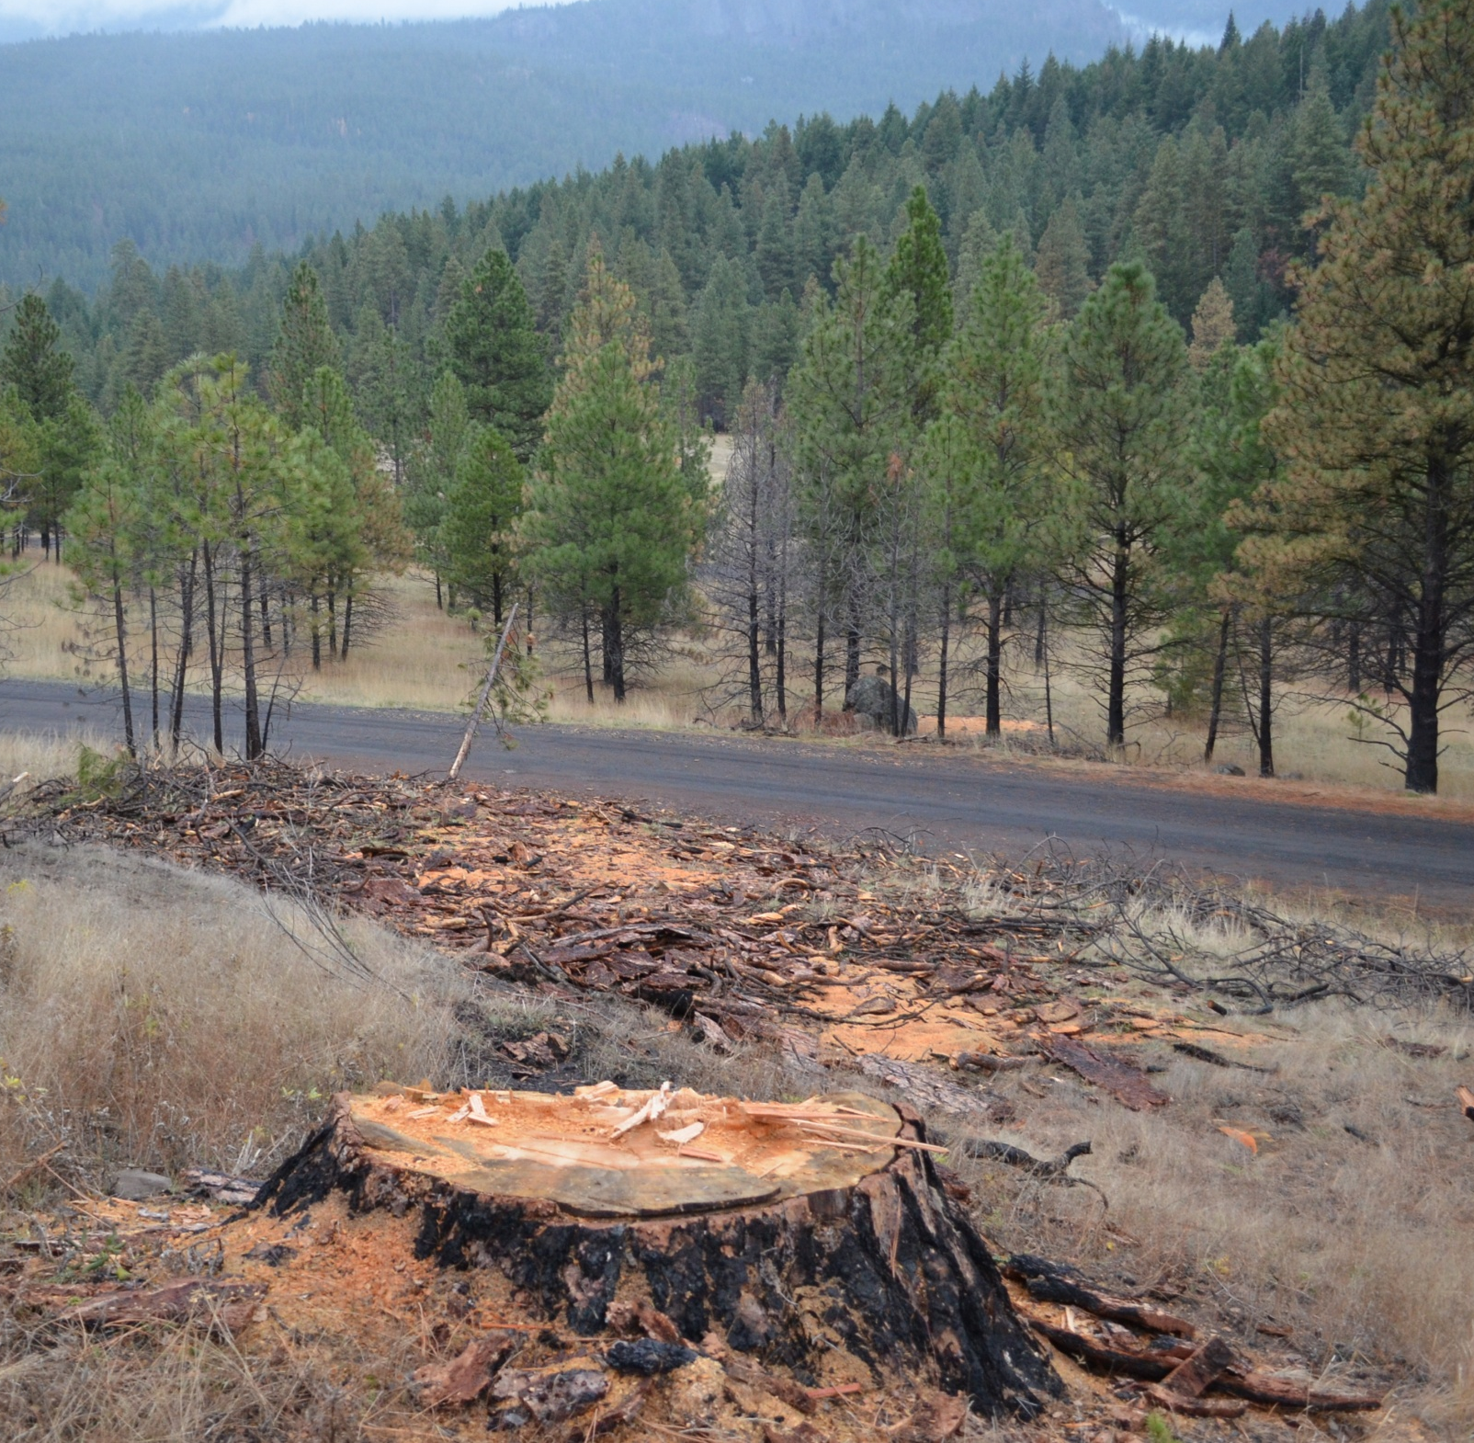
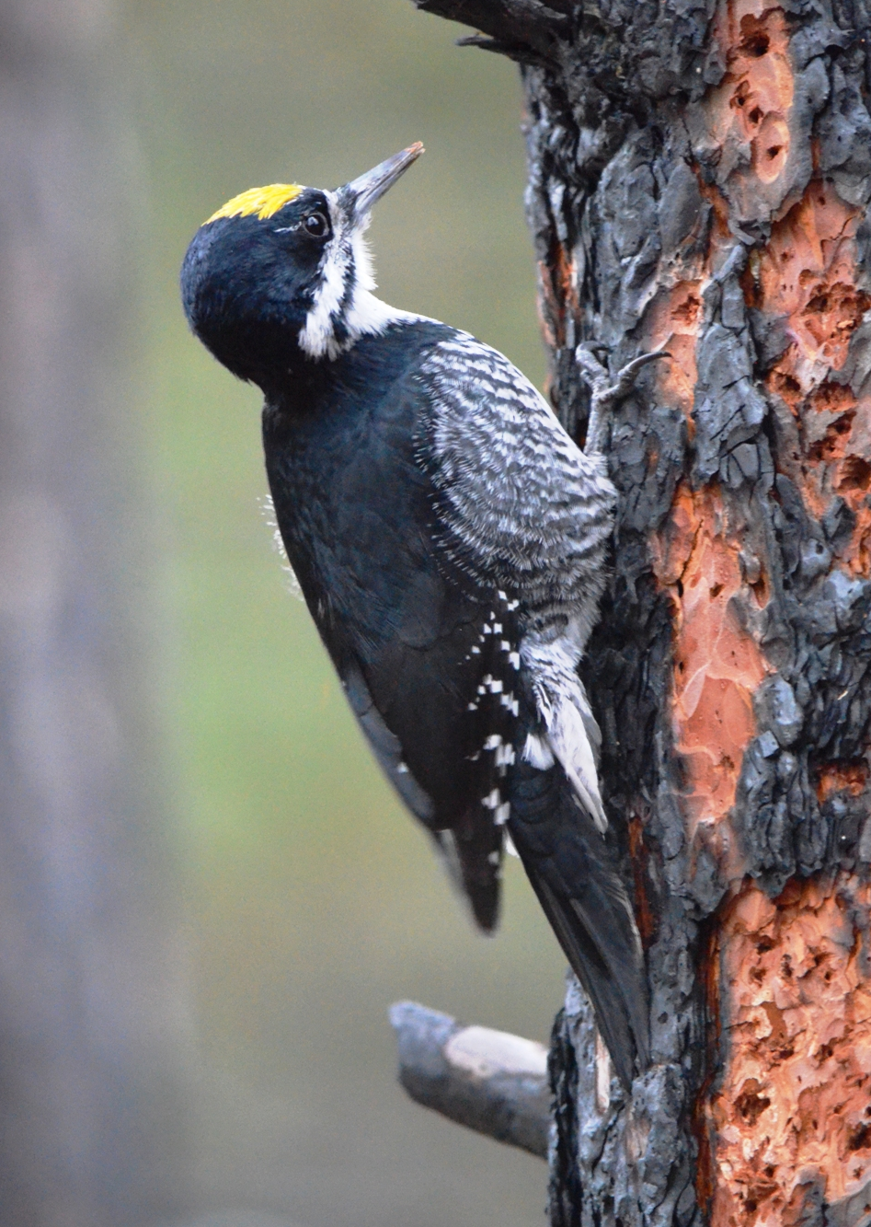
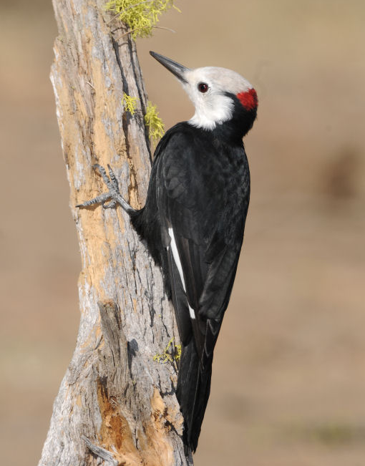
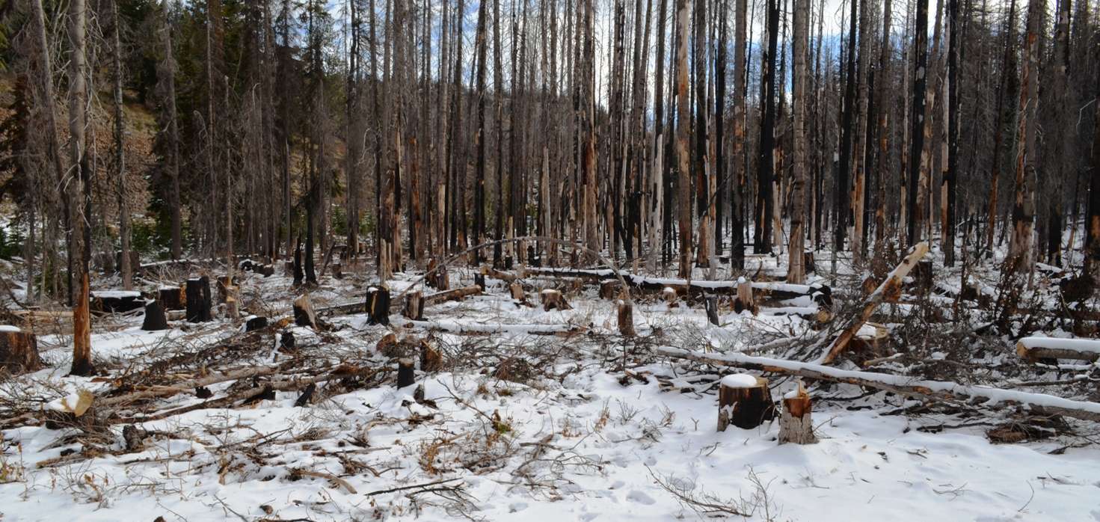
A Time for Change: A Review of US Forest Service Policies on Snag Cutting and its Impacts on Cavity-nesting Species in Eastern Washington
Teresa Lorenz, Dept. of Fish and Wildlife, University of Idaho, Moscow, ID 83844
Jeffrey M. Kozma, Yakama Nation, Timber, Fish and Wildlife/Fisheries Resource Management, Toppenish, WA, 98948
Introduction
Potential Impacts of OWNF Firewood Cutting Policy
In western conifer forests, snags are important to woodpeckers because most species require snags in which to excavate cavities and they forage on recently dead trees for insect prey. In turn, their cavities provide nesting and roosting sites for other species. In total, at least 96 wildlife species are associated with snags in forests of WA and OR (Beschta et al. 2004).
In WA, the Okanogan-Wenatchee National Forest (OWNF) includes more than 1.6 million ha along the eastern side of the Cascade Range. The OWNF is managed under a multiple use concept to provide the public with a variety of benefits (water, wildlife, wood, recreation, etc.) and where management emphasizes the maintenance and enhancement of sustainable ecosystems. It is also home to several woodpeckers that are listed as WA Species of Concern (Fig. 1).
One public use of the OWNF is the harvest of firewood requiring a Forest Products Removal Permit ($20). This permit allows the removal of ≤10 cords of wood for personal use and allows the cutting of snags unless they are marked with paint, ribbon and/or signs, or they contain cavities, nests, or broken tops. Firewood cutting is not allowed within 300 ft of streams, lakes, ponds or wet areas. However, we have documented multiple instances where these conditions have been violated Fig. 2, 3, Table 1).
LARGE SNAGS – The largest snags are often selected for by woodcutters, while research shows that large-diameter snags are preferred by wildlife for foraging and nesting (Christman and Dhondt 1997, Everett et al. 1999, Ganey and Vojta 2004). In some areas, we documented mean diameter of cut snags was 42.2 cm (n = 169) while the mean diameter of standing snags was 11.7 cm (n = 121) (Fig. 2).
SPRING HARVEST –Firewood cutting occurs during the nesting season for birds and often occurs in close proximity to active nests or results in the falling of snags containing active nest cavities (Kozma 2011; Fig. 3).
ANY SNAG MAY BE CUT – Aside from firewood cutting, the OWNF allows the cutting of any snag year-round as long as it is not transported off site (OWNF pers. comm.). Consequently, many snags are felled during hunting season for campfire wood and snags can be felled anywhere on the OWNF, including in Northern Spotted Owl (Strix occidentalis) habitat reserves.
LACK OF ENFORCEMENT – We have documented multiple wood-cutting violations each year while conducting field research (Table 1). Thus, woodcutters are not willing to police themselves, while the OWNF is not adequately staffed to enforce firewood cutting policies.
NO LIMIT ON PERMITS ISSUED – The OWNF does not limit the number of firewood cutting permits issued per year and does not monitor snag densities in areas used for woodcutting. This may lead to the overharvest of snags. For example, we have seen snag densities decline from 640 to 115 snags/ha in a recent burn on the OWNF (Fig 4). This is lower than the 200-300 snags/ha recommended in salvage-logged forests for wildlife (Saab and Dudley 1998, Hutto 2006, Saab et al. 2009, 2011).
Figure 2. A burn where illegal woodcutting (left) and illegal off-road driving by woodcutters (right) occurred in 2013 on the OWNF. These photos were taken within 75 m of a BBWO nest and 250 m of a WHWO nest. Woodcutters selectively cut the largest diameter snags (left) – the same snags favored by woodpeckers.
photo courtesy of George Vlahakis
Table 1. Firewood cutting violations observed on the Naches Ranger District, OWNF.
Violation | Year | Location
Firewood cutting outside designated woodcutting areas | Yearly (2004 – 2013) | Junction of USFS Road 1600 and 1605, USFS Road 1611
Firewood cutting within 300 ft of water | 2010, 2013 | USFS Road 1611, Nile Creek
Firewood cutting outside designated woodcutting areas | 2013 | Wildcat Creek, Oak Creek
Cutting of snags with holes and/or broken tops | 2008, 2009, 2012, 2013 | USFS Road 1600, Oak Creek, Rattlesnake Creek, Tieton Basin
Firewood cutting within 200 ft. of Tieton Rd and US HWY 12 | 2013 | Tieton Road
Cutting of a snag containing an active White-headed Woodpecker nest | 2009 | USFS Road 214
photo by George Vlahakis
Figure 1. A male Black-backed Woodpecker (BBWO, Picoides arcticus; left), White-headed Woodpecker (WHWO, P. albolarvatus; center) and American Three-toed Woodpecker (ATTW, P. dorsalis; right). All are WA Candidate Species and keystone cavity excavators that may be detrimentally affected by woodcutting on National Forests.
Figure 3. A cut WHWO nest snag containing three nestlings when felled (left), and a large pile of slash left in-place from a felled ponderosa pine snag (right) on the OWNF. Both violate woodcutting permits, which prohibit the cutting of snags with holes and require slash to be scattered after snag-felling.
Detrimental to Habitat Restoration?
The OWNF is implementing a Dry Forest Restoration Strategy where the WHWO and BBWO are focal species. The OWNF intends to improve WHWO habitat by removing understory trees, retaining large diameter trees, and understory burning in the ponderosa pine (Pinus ponderosa) cover type.
However, much of the restoration zone falls within firewood cutting areas, which could have negative impacts on the woodpeckers the Strategy is intended to benefit. For example, 72% of WHWO and 79% of BBWO nests we monitored were in woodcutting areas and 50% of forest dominated by Ponderosa Pine (WHWO habitat) is in woodcutting areas.
Additionally, plies of slash and logs left by woodcutters present a potential fire hazard that may counter the efforts of the OWNF to restore natural fire regimes (Fig. 3, 4). These piles also can create habitat for nest predators such as chipmunks (Tamias spp.) and pine squirrels (Tamiasciurus spp.) (Carey 1995, 2000, Converse et al. 2006).
Recommendations
The OWNF should not allow standing snags to be cut , instead allowing only downed and dead wood to be removed for firewood; a policy already in place on state lands.
To further reduce negative impacts of firewood cutting on cavity-nesting species, the OWNF should close firewood cutting from May 1- July 15.
Only allow wood-cutting in areas adequately staffed by law enforcement officers, to ensure the public adheres to OWNF policies.
Add signs on main USFS roads indicating the boundaries of firewood harvest areas.
Figure 4. A burn previously used for nesting by BBWO and ATTW on the OWNF. Foreground shows heavy use by woodcutters in 2013, reducing snag densities up to 95% - a decline similar to that resulting from salvage-logging.

