Slide 1
Yakama Nation Fisheries and the Columbia Basin Fish Accords Update
Yakama Nation General Council Annual Meeting, January 2024

Slide 2
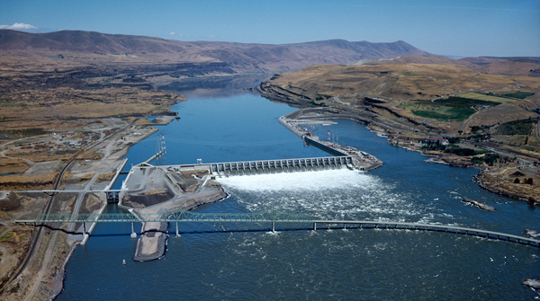
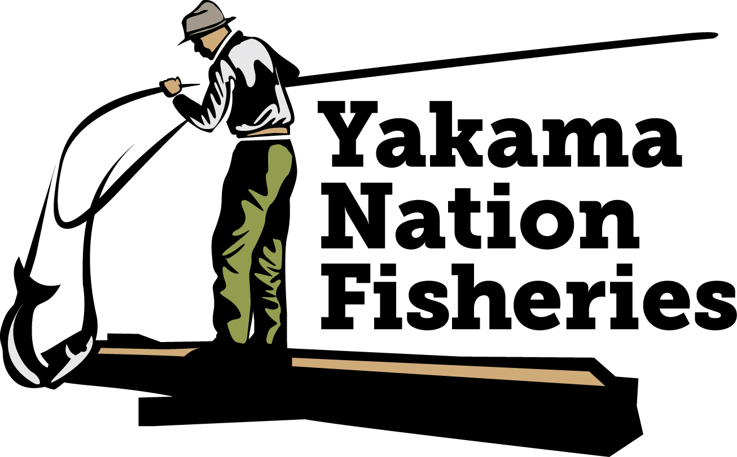
Accord Historic Context
Years of litigation over federal Columbia River hydrosystem operations
In 2008, the BPA, Army Corps of Engineers, and Bureau of Reclamation, entered into a 10-Year Columbia Basin Fish Accords agreement with the Yakama Nation, Umatilla, Warm Springs, and CRITFC
“2008 Fish Accords”
2

Slide 3
Accord Policy Objectives
Expand Treaty fishery management capacity, consistent with its sovereignty and co-management authority
Put an end to over 15 years of litigation which, while generally successful, had not produced significant new or additional federal actions or commitments to improve fish habitat or abundance.
Secure long-term, stable funding for current and additional fisheries projects (both ESA and non-ESA).
Provide guaranteed spill at Columbia River System dams, and a seat at the table for tribes to support ongoing Treaty fisheries advocacy in hydro management.
3

Slide 4
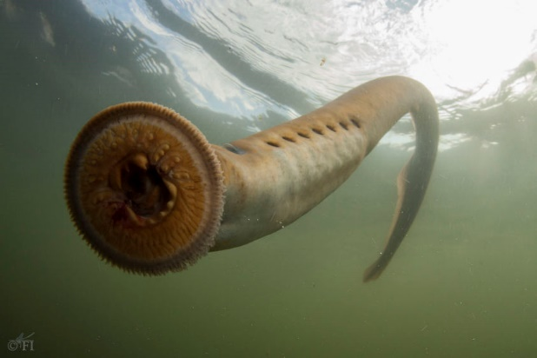
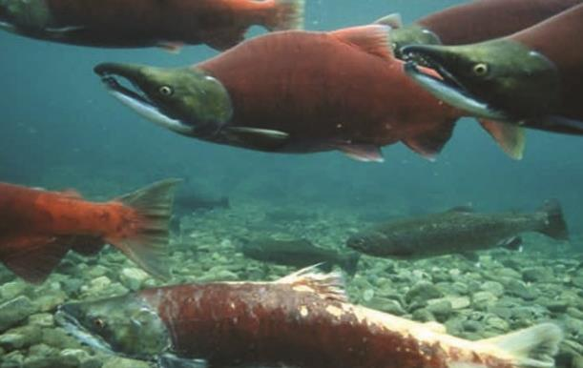
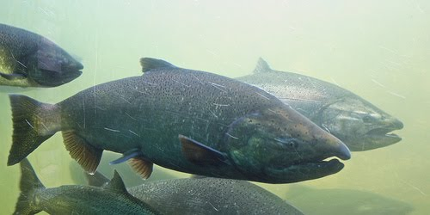
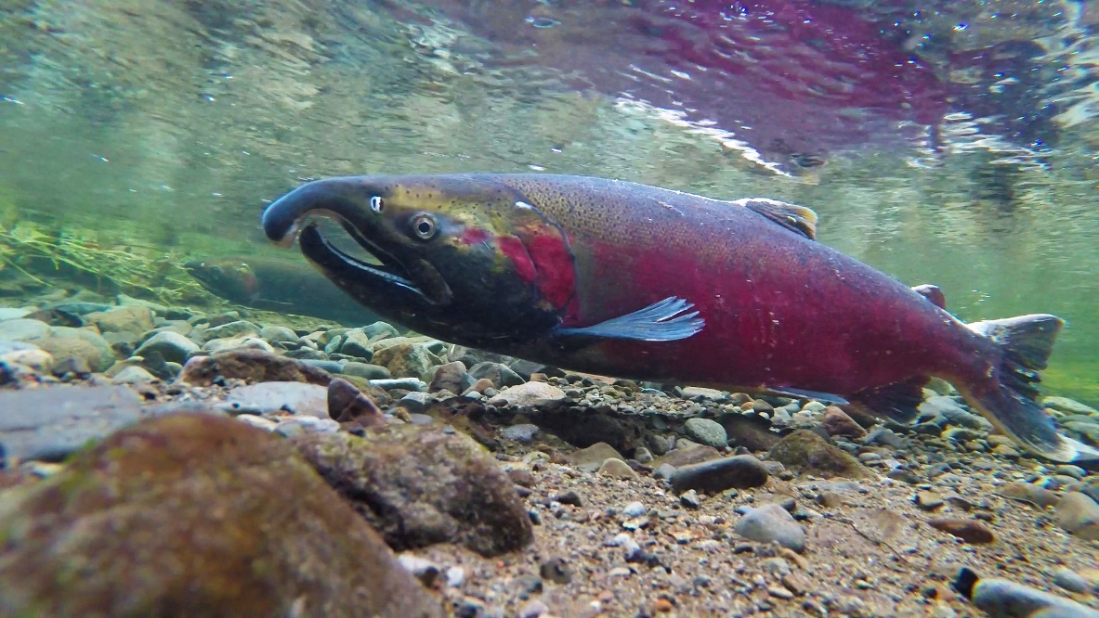
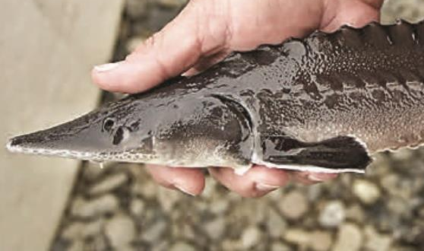
Historic Benefits: ESA & Non-ESA Species
Yakima Basin
Klickitat Basin
Upper Columbia
Mainstem Columbia
Spring Chinook
Summer Chinook
Fall Chinook
Steelhead
Coho
Pacific Lamprey
Spring Chinook
Steelhead
Spring Chinook
Steelhead
Coho
Pacific Lamprey
White Sturgeon
Shusháynsh
Asum; K’súyas
Kálux
Tkwinat; Núsux
Sinux
Wilaps
4

Slide 5
Benefits: Stable Funding
Historically: YN competed for funding on annual funding cycles
Limited project scale & inhibited strategic planning
Significant staff time to compete
Now: Stable funding and carryforward allows YN to spend majority of funds
Accord enables large scale restoration, cost shares, experimental projects
Facilitates YN leadership in regional habitat project design, prioritization
Hire and keep excellent staff – maintain low employee turnover rates
5

Slide 6
Leadership in Implementing Fish & Wildlife Management Projects
Accord Implementation: YN Status and Trends Reporting
2008-2023
See: yakamafish-nsn.gov
➔Our Work ➔ Videos, Restoration Stories
Metrics reported as of 1/11/2024
6

Slide 7
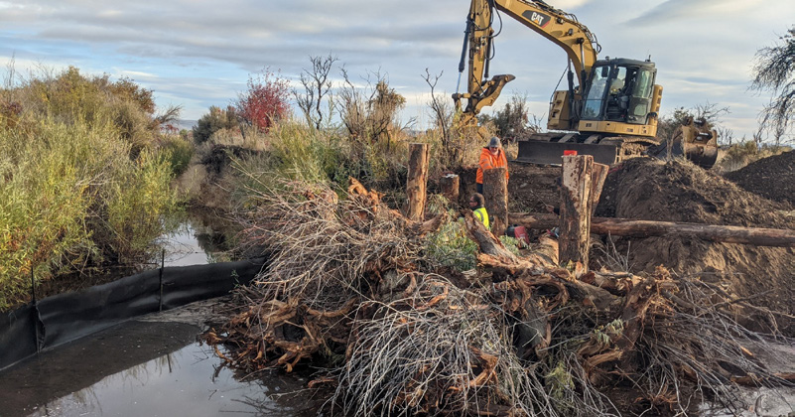
2023 Highlights:
Habitat Restoration
3 habitat restoration projects in Upper Columbia
Upper Yakima large wood, vegetation replanting
Fish passage, habitat improvements in Simcoe and Wahtum Creeks
Southern Ceded wet meadow, flow restoration, passage improvement
7

Slide 8
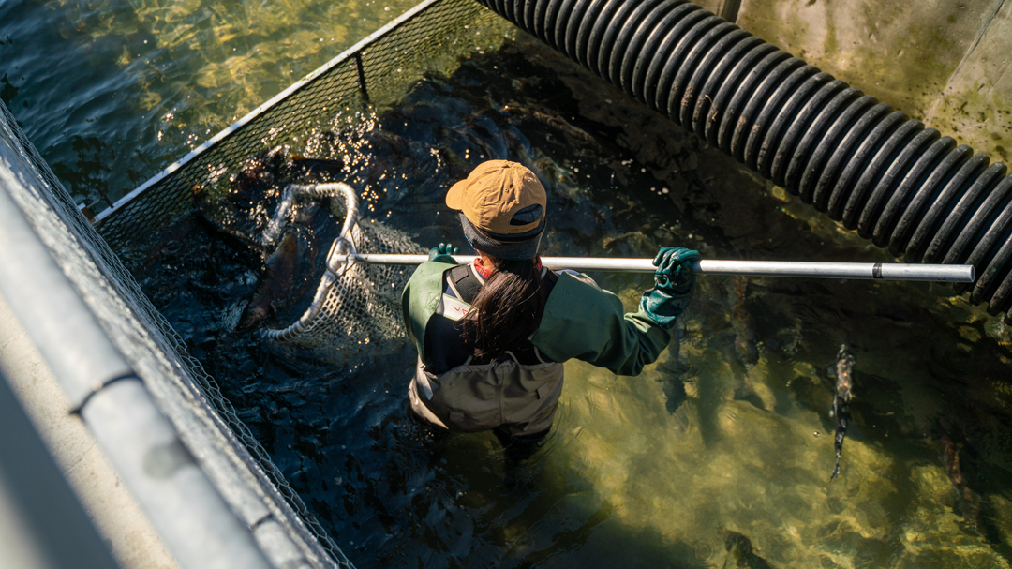
2023 Highlights: Hatcheries/ Production
Working towards on-reservation trout production facility
Expansion of Upper Columbia multispecies acclimation and kelt reconditioning
Expansion of white sturgeon production and restoration
Klickitat Hatchery upgrades, expanding spring Chinook production
Translocated Pacific Lamprey successfully reproducing
8

Slide 9
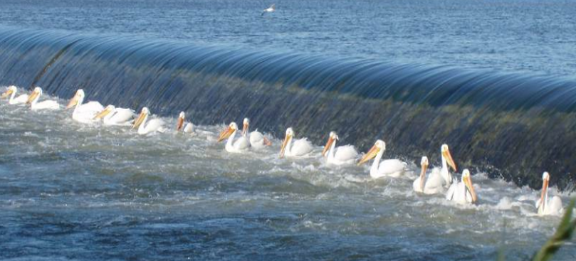
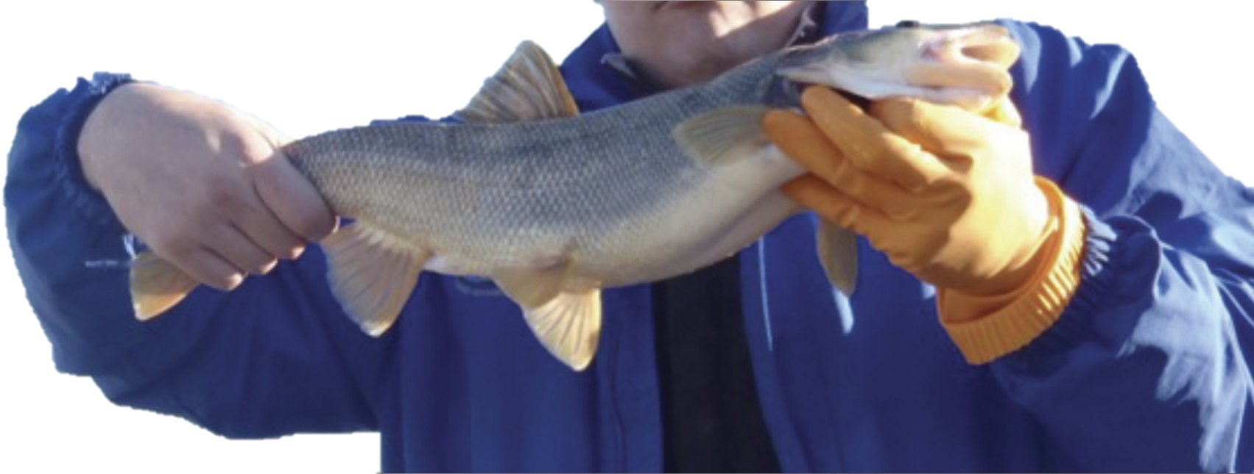
2023 Highlights: Hydro
YN participated in negotiation of a Stay of Litigation in the ongoing hydro system lawsuit
Secured “whole of government” approach to restoring salmon in the CRB
Presidential Memo directing federal agencies restore healthy and abundant populations
Compromised on hydro operations due to explicit path to dam breaching
9

Slide 10
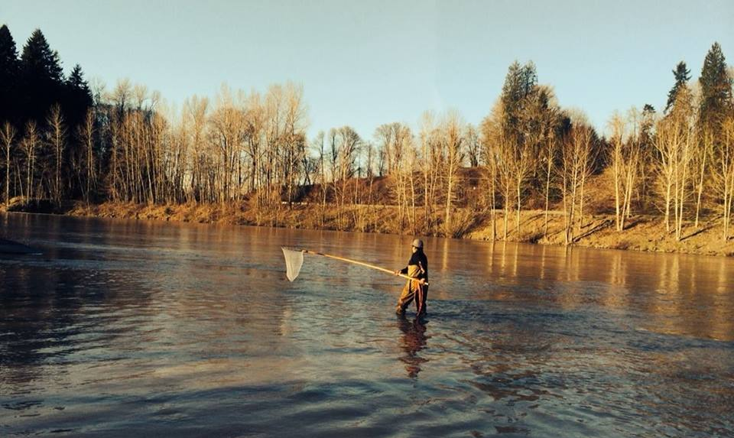
2023 Highlights: Harvest
Although Tribal Harvest numbers dipped during the recent 5 years, last year they returned to above the previous 10-year average.
10

Slide 11
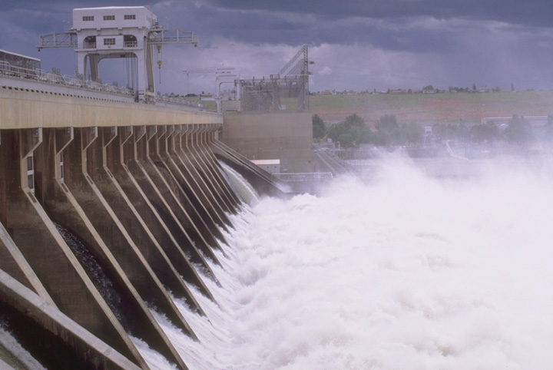
Historic Benefits: Hydro Operations
2008 Fish Accord provided 10 years of guaranteed spill levels for fish.
2018 Extension led to implementation of regional Flex Spill Agreement:
Provided increased spill for fish (particularly spring juveniles), up to 125% total dissolved gas
Allowed spill timing flexibilities to maximize both power and fish benefits
Continued funding for the Fish Passage Center, which provides technical analysis regarding hydro operations and fisheries impacts.
11

Slide 12
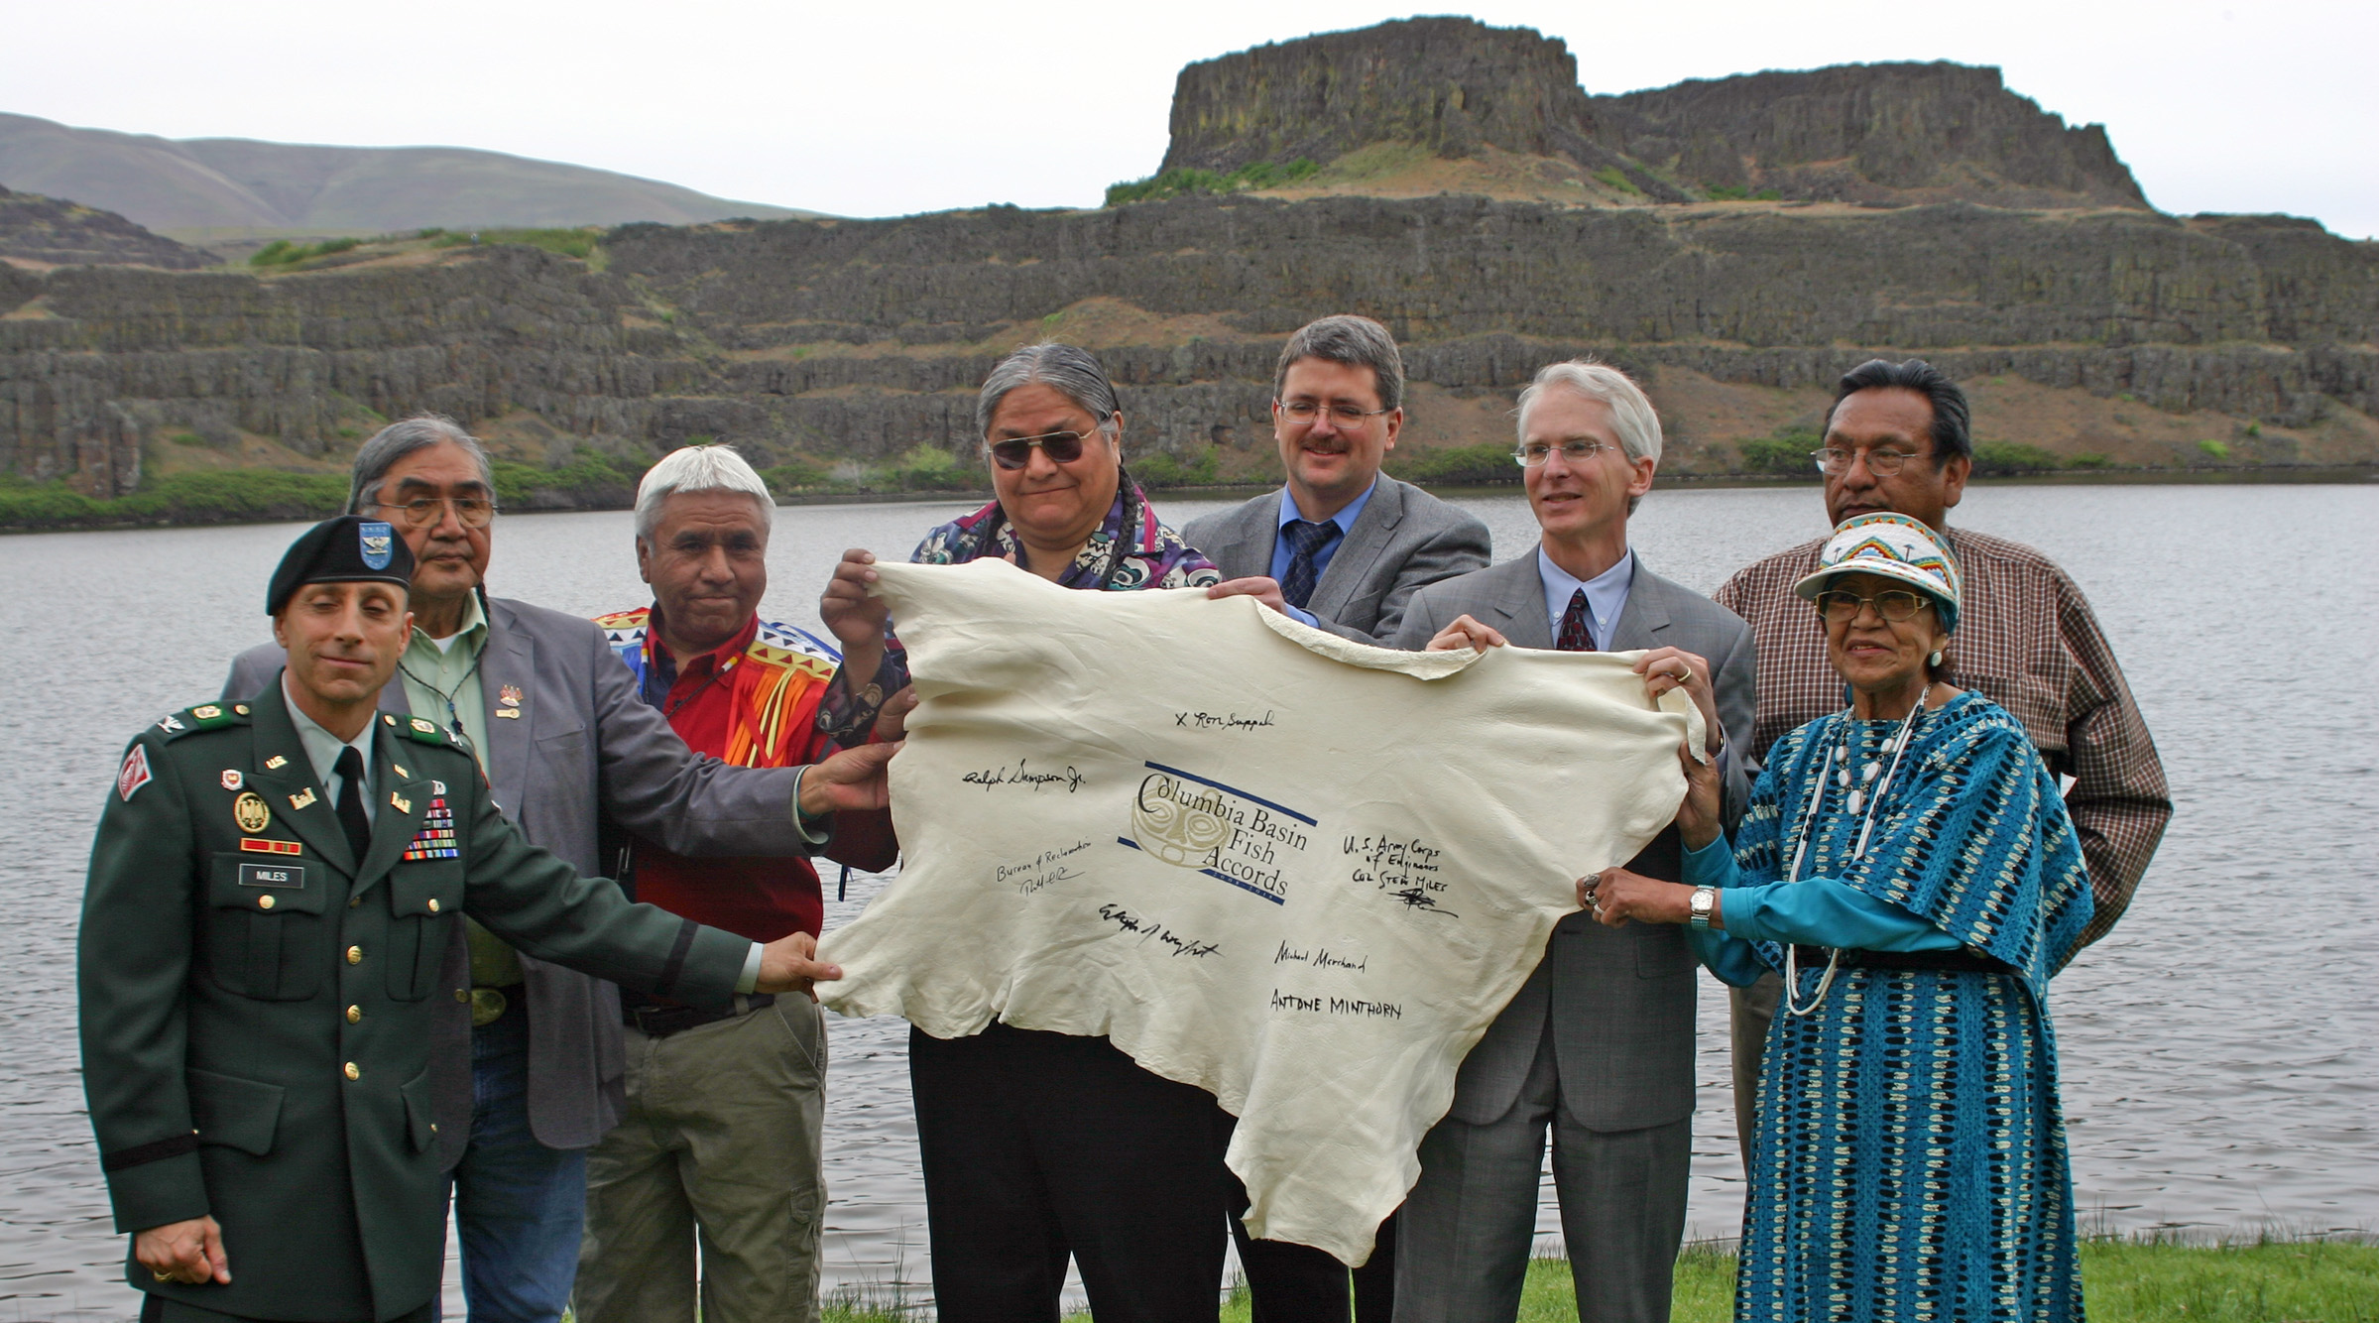
Benefits: Partnership
‘Accord table’ to quickly elevate & resolve concerns with project implementation and hydro operations.
Recognition of Tribal expertise in project selection and implementation:
“The Tribes, as long-term stewards cultural stewards of their treaty resources and legal co-managers of treaty resources, have developed extensive project and resource expertise. The Action Agencies recognize the Tribes’ substantial expertise regarding the biological, physical, cultural and social environments within which they operate to manage treaty fisheries and implement projects.”
12

Slide 13
Evolution of Litigation Prohibitions:
2008 “Complete Forbearance”: The 2008 Accord expressly prohibited Columbia Basin and Snake River Basin dam removal advocacy of all kinds, in addition to requiring tribal affirmations of legal adequacy regarding the 2008 plan of operations.
2018 “Affirmation of Adequacy”: The 2018 Accord required tribes to affirm that improved “flex spill” hydro system operations + Accord commitments satisfied the federal agencies’ legal obligations under the Endangered Species Act, the Northwest Power Act, the Clean Water Act, and the National Environmental Protection Act. However, it permitted dam removal advocacy on other grounds (e.g. cultural resource and general tribal policy grounds).
13

Slide 14
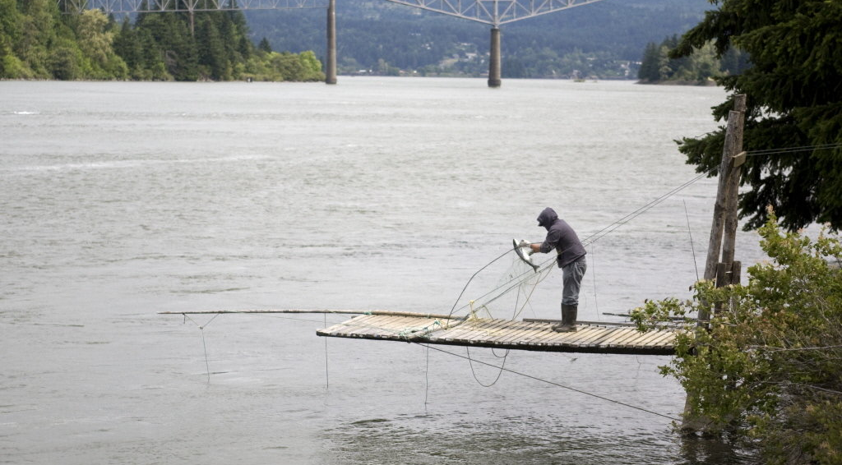
Evolution of Litigation Prohibitions:
2020 & 2022 “Just Don’t Sue”: The 2020 Accord and 2022 Amendment permit the tribes to question the legal adequacy of the federal hydrosystem operations, and engage in all types of technical and policy advocacy for fisheries mitigation and hydro operations actions, including dam removal; provided, that they do not sue the Action Agencies under the NWPA, ESA, CWA, or associated procedural statutes.
The Fish Accords do not prevent Yakama Nation from filing Treaty-rights claims if necessary.
14

Slide 15
2022 Amendment & Supplemental Agreement
15

Slide 16
2022 Fish Accord Amendment
Extends the term of the Fish Accords, and maintains general Accord commitments, through Sept. 30, 2025
Updates BPA funding commitments:
Restores annual base budget (~$2 million for FY23, ~ 2 years worth of the savings YN granted in the 2018 Accord)
Provides 2.5% inflation adjustments to base budget in FY24 and FY25
Removes annual budget cap (was 120%) on use of carryforward funds in each fiscal year, the Tribe’s full carry-forward balance will be available for allocation across its Accord project portfolio
Affirms BPA’s continuing capital project commitments
16

Slide 17
2022 Fish Accord Amendment
Memorializes BPA’s commitment to consider fish & wildlife needs when distributing unexpected power revenue*
Reaffirms the Action Agencies’ commitment to negotiate an updated, long-term Accord package
Maintains and enhances ‘off ramp’ flexibilities that would allow YN to withdraw from the Accords if necessary
*BPA has proposed that $50M from FY22 UPRs (10% of total UPRs) go to priority fish hatchery needs, including ~$6.4 million to YN’s hatchery needs; but this proposal must still be finalized through a revenue distribution process.
17

Slide 18
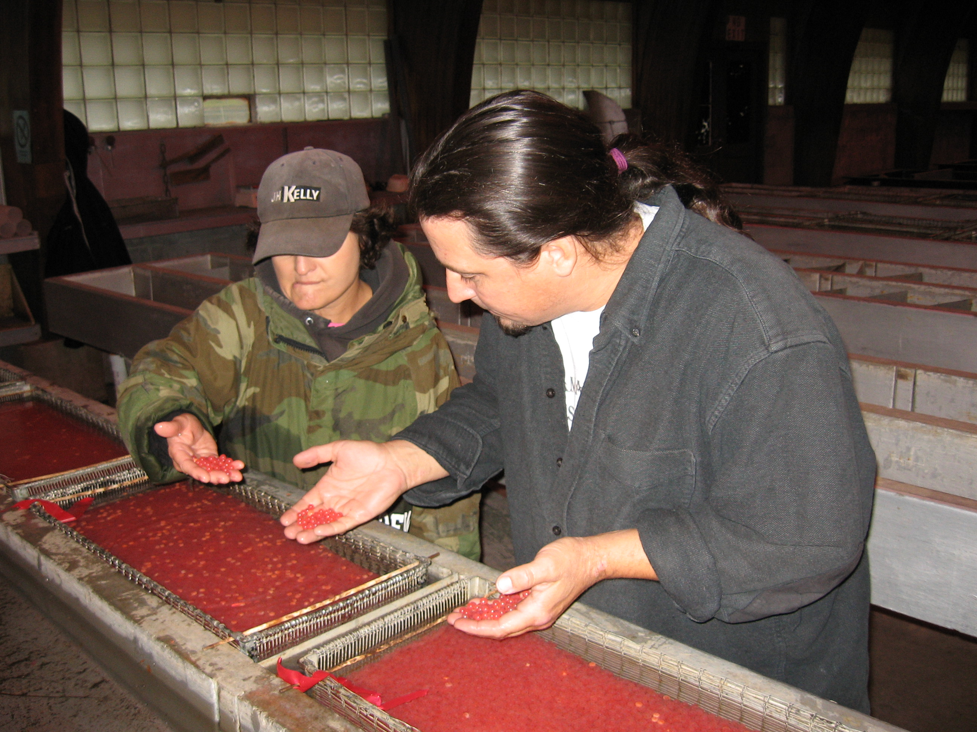
2022 Supplemental Agreement with BPA
Additional Yakama Nation hatchery project funding:
BPA commits $11.8 million in additional capital project funds for the Klickitat Hatchery upgrade
BPA commits to address appropriate additional production project funding if they become ripe during the term of the 2022 Fish Accord Amendment:
Sturgeon Hatchery Expansion Operation and Maintenance
Yakima Subbasin Summer/Fall Chinook Production Facilities Construction
18

Slide 19
2024 Fish Accord Status Update
The Yakama Nation's current Fish Accord agreement with BPA expires September 30, 2025.
As part of recent commitments made by the Biden Administration to Columbia Basin salmon restoration, BPA agreed to maintain Fish Accords funding for Columbia Basin tribes and states during the next 10 year period.
Under the direction of the Yakama Tribal Council and the F&W Committee, Yakama Nation Fisheries will work with the YN Office of Legal Counsel to negotiate a renewed agreement with BPA.
19

Slide 20
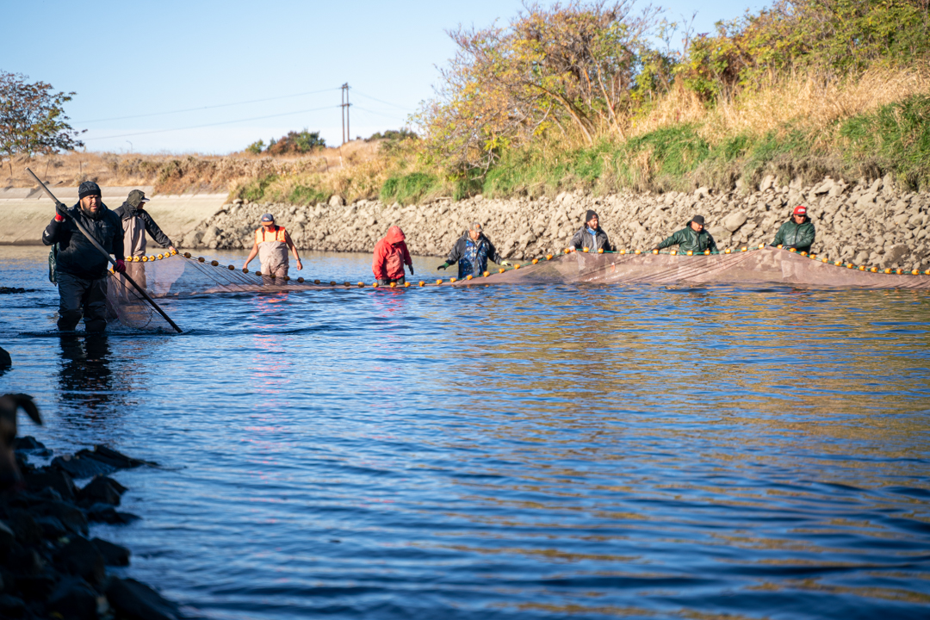
For More Information see:
yakamafish-nsn.gov
19

